Slide 1
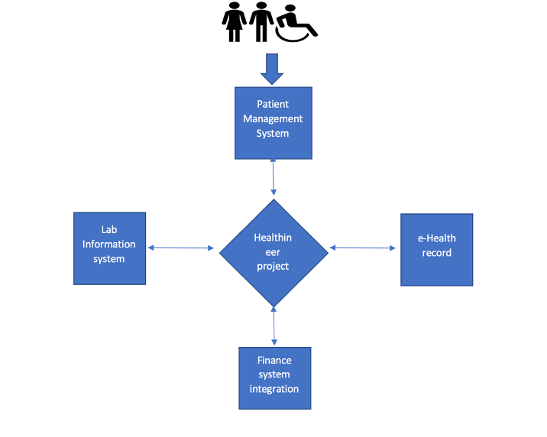
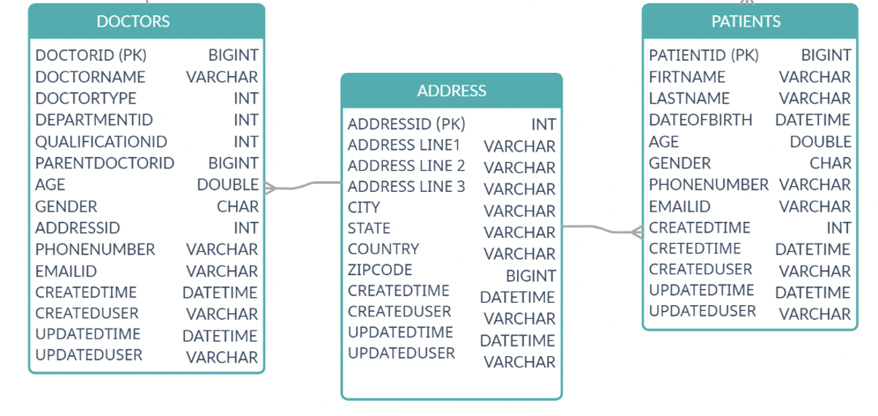
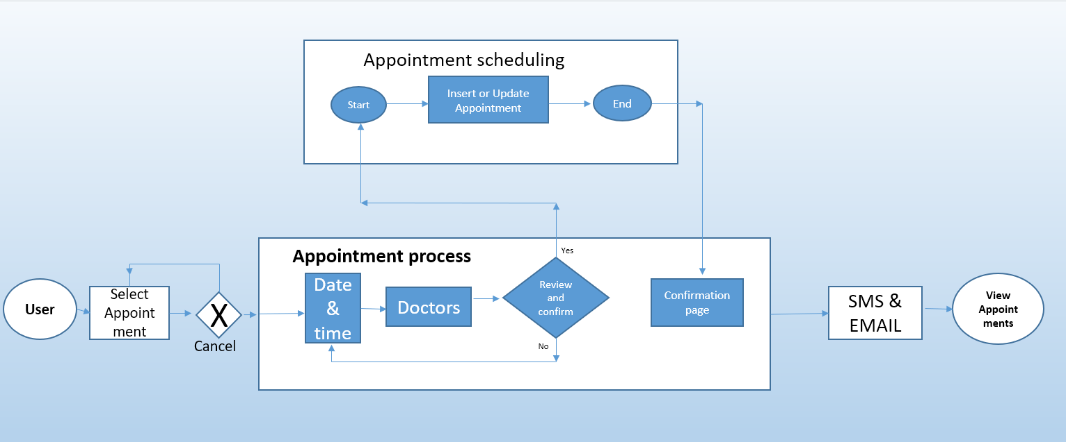
Healthineer Project
Introduction
Data has significant value for making key business decisions for any organization. This Healthineer project aims to develop a flexible database management system for Healthcare organizations using SQL for Structured data and MongoDB for Unstructured data. An Integration of four major aspects concludes the key areas of healthcare which are Patient Management Systems, Laboratory Information Systems, Finance Systems, and Electronic Health records.
Methodology
Patients can schedule and alter their appointments using the patient management system and laboratory Information systems provides the list of tests prior to the appointment if necessary and records all the Lab test reports and the rest of the data is stored in the Electronic health records. The finance systems will validate according to the patient demographic data and match their respective health insurance provider.
Concurrency control is used in this project to reduce the concurrency issues as it has multi-user access which may lead to data loss and duplication issues.
The entities that we have induced in this project are the patients’ table and doctors’ table with data types prioritizing the primary key and foreign key with the development of Azure cloud service. These services will provide 99.99% availability of and low latency with continuous support. This project is developed on the bases of DBMS SQL queries for the structure which includes logical operators like and, or, not, between, and also with arithmetical operators.
Aggregate functions, and regular and formula expressions subqueries are used in this process to smooth transition that supports the database management system.
Manipulations queries, definition queries, query language, and transaction control queries are used to construct the flexible database system.
Conclusion
A relational database management system is been used as the core database type, which connects all the relational tables like patients, doctors, schedules, logins, reports, etc. Developing a database management system is solely based on the parameterized database type, that interlinks between the datatypes. These systems are maintained efficiently by conducting timely audits and security checks, which will help the health care organization to better serve their patients with more efficiency.
Fig 1. Sequence of operations for appointment Scheduling
1) Bansal, V., Bhatia, A. B. (2015). Database Management System. United Kingdom: Alpha Science International, Limited.
2) Kumar, R., Agrawal, A., & Khan, R. A. (2020). A wake-up call for data integrity invulnerability. Computer Fraud & Security, 2020(4), 14-19.

